Slide 1


Emre Kaan Yılmaz
15.01.2024

Slide 2

Outline
Executive Summary
Introduction
Methodology
Results
Conclusion
Appendix

Slide 3
Executive Summary
Data is collected by webscrapping and API, visualized by Folium and Dash. Machine learning models and SQL commands are applied to the data. All results are presented in this document. Corresponding project files can be found in Github links.

Slide 4
Introduction
In this course, learned methodologies in IBM courses are applied to SpaceX data. It is a practice course.

Slide 5

Section 1

Slide 6
Methodology
Executive Summary
Data collection methodology:
In this project, the data is collected from the urls.
Perform data wrangling
Some basic operations are implied on the data. For example, missing value handling, html parsing, searching column names, searching titles, etc.
Perform exploratory data analysis (EDA) using visualization and SQL
Perform interactive visual analytics using Folium and Plotly Dash
Perform predictive analysis using classification models
How to build, tune, evaluate classification models

Slide 7
Data Collection
In the first part, data is collected by using requests.get() command from an url. Then, the missing values are cleared by replacing with the mean values.
In the second part, the data is collected from url in html form and parsed with BeautifulSoup. Then, search operation is done to find the title. Then, the column names in the html data is read by appending them into a list.
In the following slides, you can access the details of the commands and corresponding Github links.

Slide 8
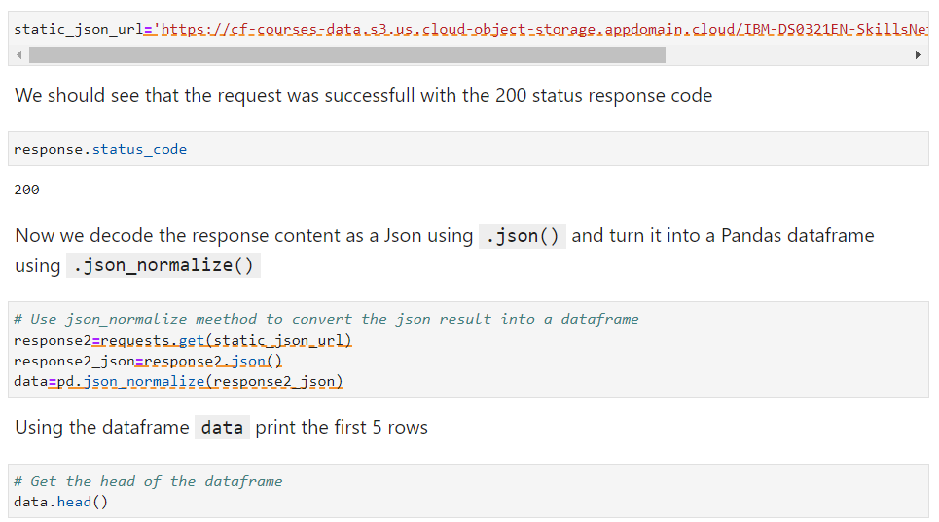
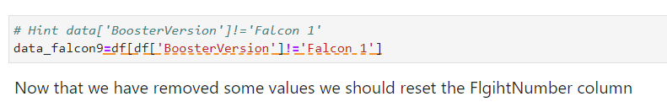
Data Collection – SpaceX API
GitHub

Slide 9
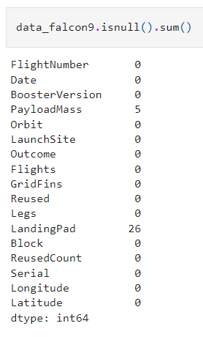
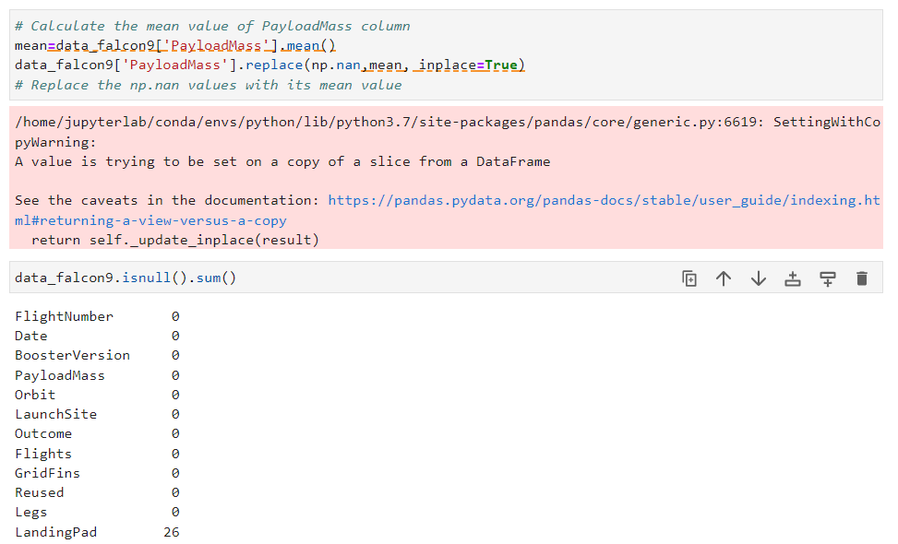
Data Collection – SpaceX API
GitHub
Before
Operation
After

Slide 10
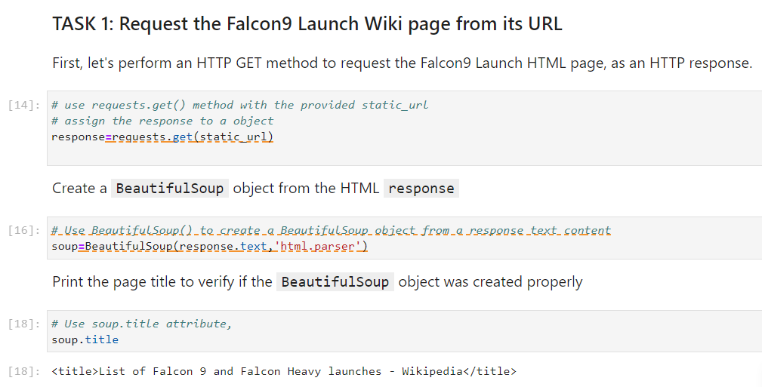
Data Collection - Scraping
GitHub

Slide 11
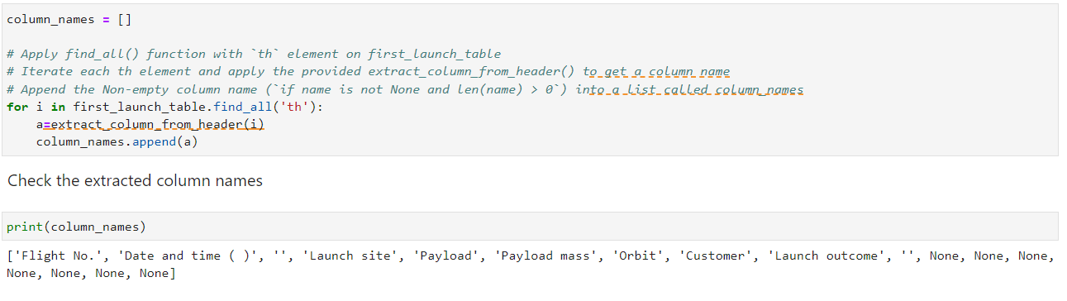
Data Collection - Scraping
GitHub

Slide 12
EDA with Data Visualization
GitHub
Scatter plot of launch site and orbit classes with flight numbers (or payload mass) with hue of classes to analyze success distribution
Line plot to see trend of class according to years
Box plot to see class values of different orbits

Slide 13
EDA with SQL
Using bullet point format, summarize the SQL queries you performed
Add the GitHub URL of your completed EDA with SQL notebook, as an external reference and peer-review purpose
GitHub

Slide 14
Build an Interactive Map with Folium
GitHub
Circle and marker is used to mark Launch Sites.
Successful and unsuccessful launches are marked with colored markers.
MousePosition object is created to see coordinates of mouse in the map.
Markers are used to show closest city, road, railway, coast. Then, lines are used to draw distance.

Slide 15
Build a Dashboard with Plotly Dash
GitHub
A dropdown list to select launch site is added. The pie chart below shows launch success for selected launch site or success percentages of all launch sites. The interaction between them exists because of the callback function.
Slider is added to payload mass. Scatter plot shows successes for the range selected from the slider by using callback functions.

Slide 16
Predictive Analysis (Classification)
GitHub
Train Models: Fit each model to the training data.
Hyperparameter Tuning: Use techniques like GridSearchCV or RandomizedSearchCV to find the best model parameters.
Evaluate models: I used scores and confusion matrices to evaluate models.

Slide 17

Section 2

Slide 18
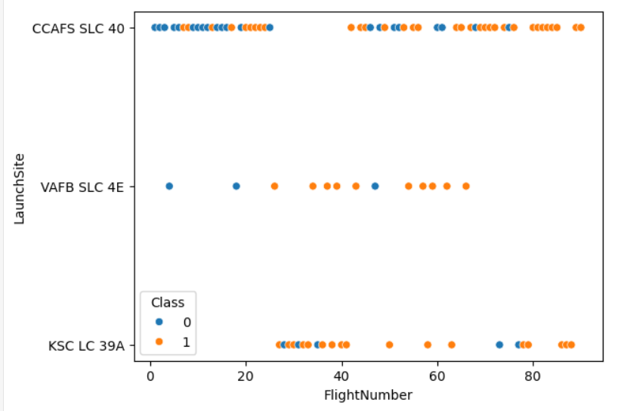
Flight Number vs. Launch Site
CCAFS SLC 40 has low success rate in the initial flights but has higher success rate in the later flights. It has lower success rate for the other launch sites.
VVAFB SLV 4E has lower amount of flights. It has higher success rate than CCAFS SLC 40 launch site.
KSC LC 39A has medium number of flights. It has higher success rate than CCAFS SLC 40 launch site.

Slide 19
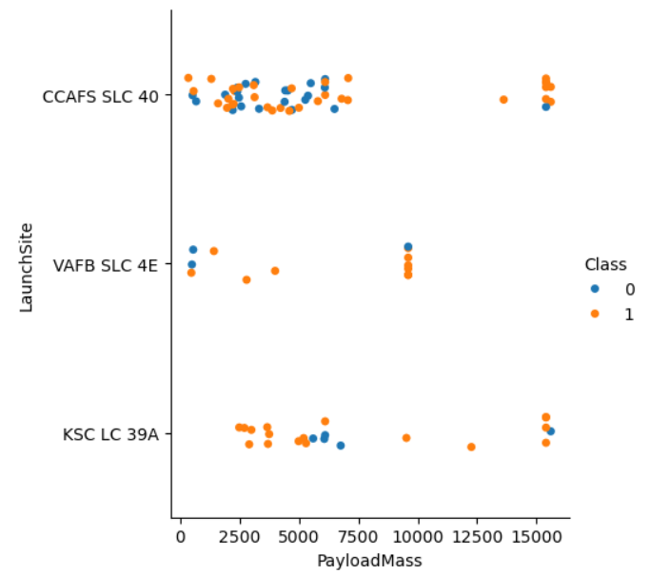
Payload vs. Launch Site
CCASFS SLC 40 has more than %70 success rate for payload mass higher than 12500kg. It has no flights between payload mass of 10000 and 12500 kgs.
VAFB SLC 4E has around %65 success rate for payload mass lower than 5000kg. It has higher success rate for 7500kg.
KSC LC 39A has only 2 successful flights between 7500 and 15000kgs payload mass. It has 3 successful flights and an unsuccessful flight for payload mass higher than 15000kg. Also, It has success rate more than %50 for payload mass lower than 7500 kg.

Slide 20
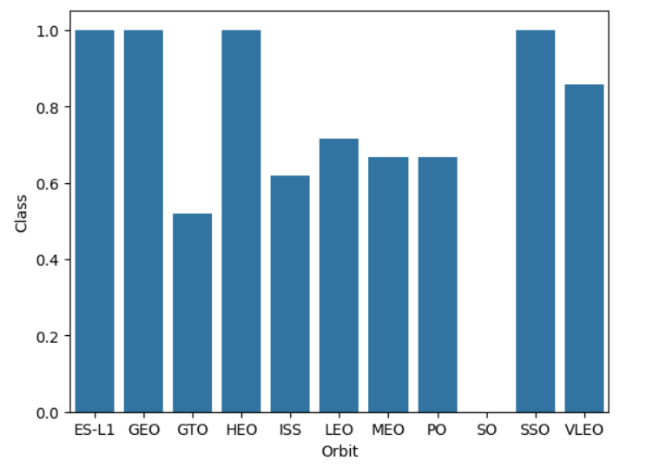
Success Rate vs. Orbit Type
Some orbits have %100 success rate.

Slide 21
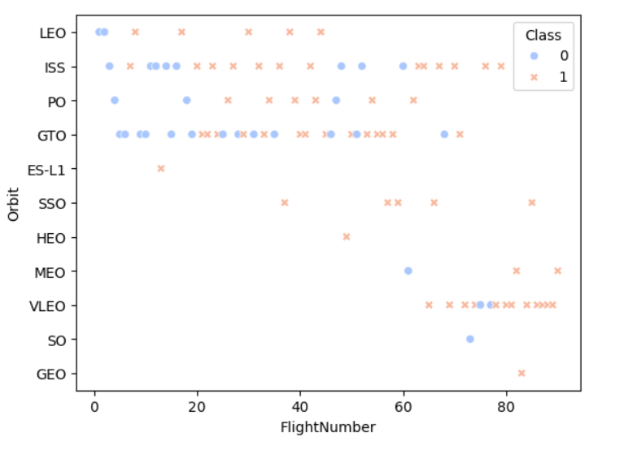
Flight Number vs. Orbit Type
ES-L1, SSO, HEO and GEO orbits have only unsuccessful flights.
MEO, VLEO, SO and GEO orbits started to operate for after flight number 60.
LEO, ES-L1 and HEO orbits stopped working for after flight number 60.
Orbits have lower success rate than %50.
ES-L1, SSO, HEO, MEO, SO and GEO has lower than 6 flight attempts.

Slide 22
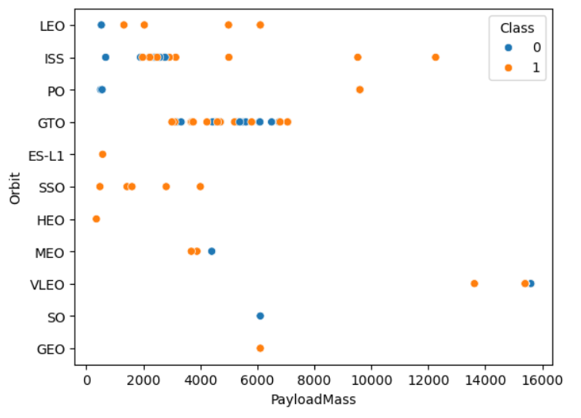
Payload vs. Orbit Type
Orbits which make flights with higher payload mass than 7000kg has higher success rate for high payload masses.
LEO, ES-L1, SSO, HEO and MEO has only flights with lower than 6000kg payload mass and they have high success ratio.

Slide 23
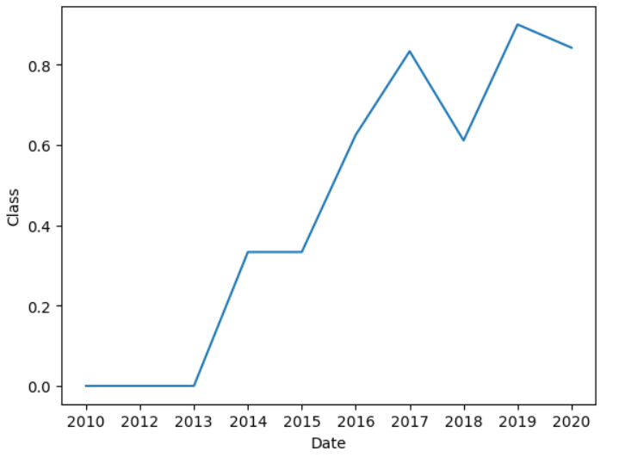
Launch Success Yearly Trend
Launch success has positive trend for date although it has some fluctuations after 2017.

Slide 24
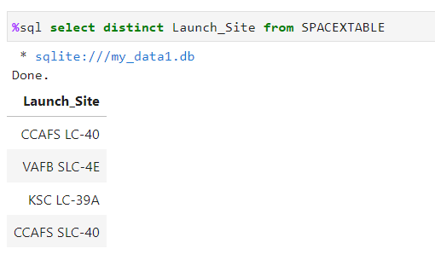
All Launch Site Names
Basic distinct command is utilized to the Launch_Site column.

Slide 25
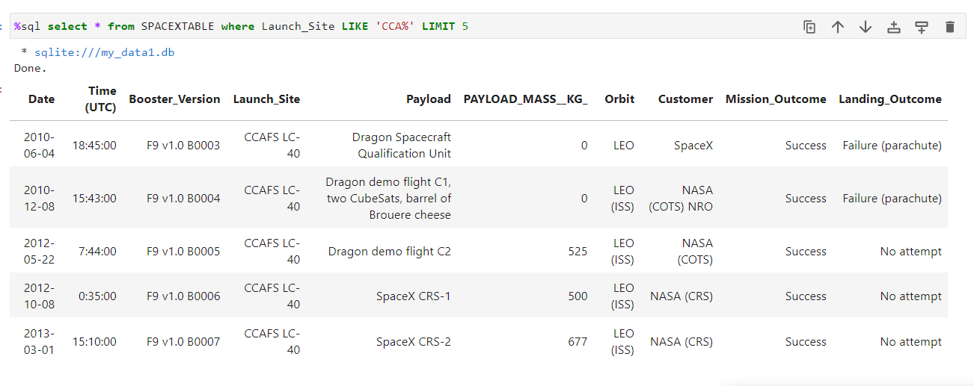
Launch Site Names Begin with 'CCA'
Like command is utilized with Limit command.

Slide 26
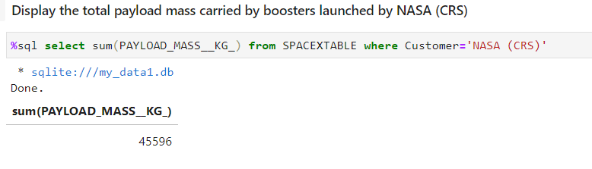
Total Payload Mass
Calculate the total payload carried by boosters from NASA
Sum command is utilized with a filter on customer column.

Slide 27
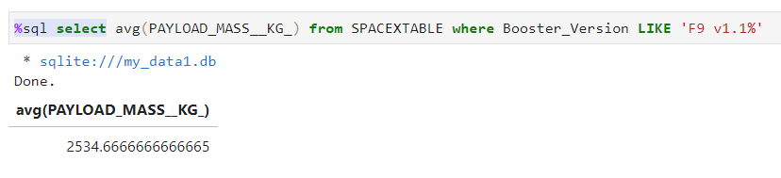
Average Payload Mass by F9 v1.1
Calculate the average payload mass carried by booster version F9 v1.1
Average payload mass is calculated by utilizing avg() command with a filter applied to the Booster_version column.

Slide 28
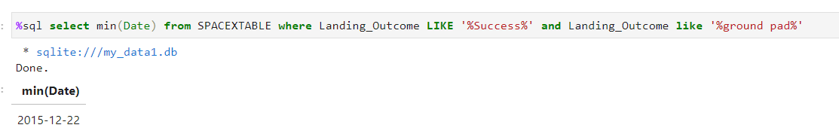
First Successful Ground Landing Date
Find the dates of the first successful landing outcome on ground pad
This query utilizes min command with a filter on the Landing_Outcomes column in order to find the initial date.

Slide 29
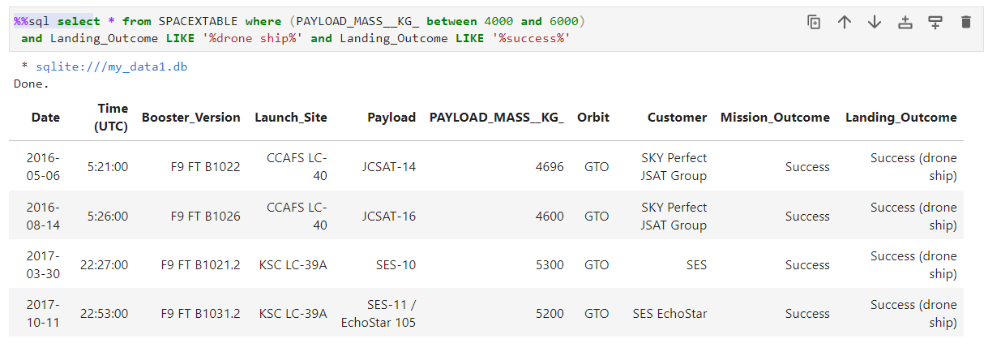
Successful Drone Ship Landing with Payload between 4000 and 6000
List the names of boosters which have successfully landed on drone ship and had payload mass greater than 4000 but less than 6000
This query utilizes between structure in the where part with other necessary filters.

Slide 30
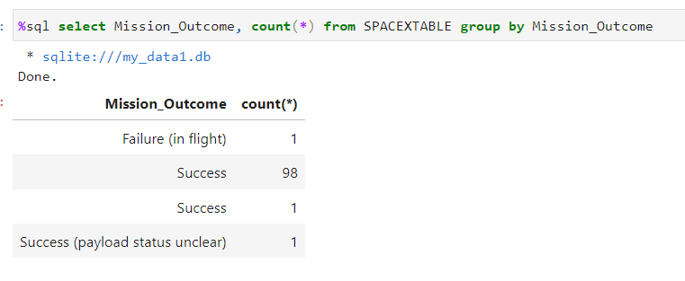
Total Number of Successful and Failure Mission Outcomes
Calculate the total number of successful and failure mission outcomes
This query counts the number of rows for each value at the mission_outcomes column by grouping them.

Slide 31
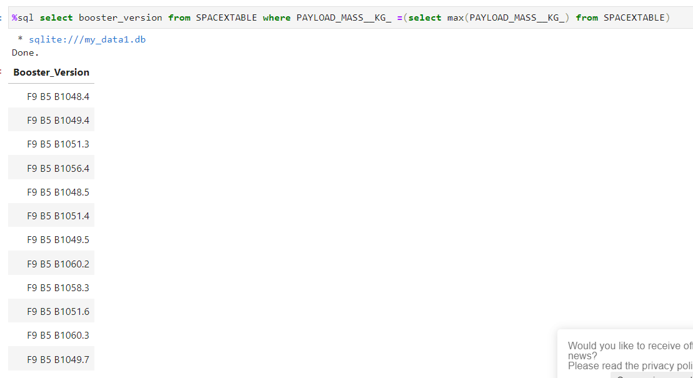
Boosters Carried Maximum Payload
List the names of the booster which have carried the maximum payload mass
Boosters carried maximum payload has been found by filtering the payload_mass_kg column with the maximum payload_mass_kg_ value found by a subquery.

Slide 32
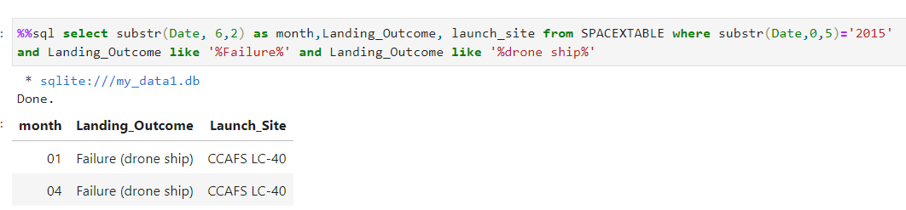
2015 Launch Records
List the failed landing_outcomes in drone ship, their booster versions, and launch site names for in year 2015
Substr command applied to date column (which is in a string form) in order to obtain year and month information. Then, filters applied and required information is derived.

Slide 33
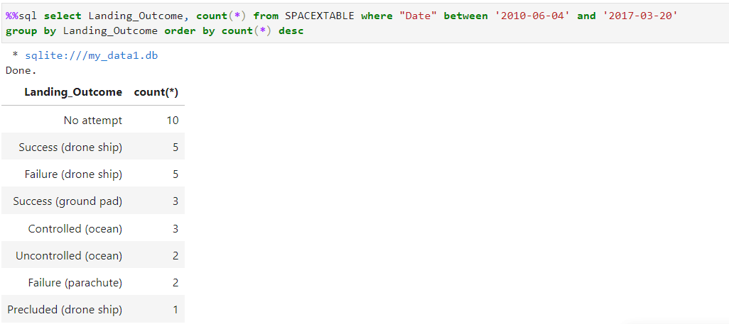
Rank Landing Outcomes Between 2010-06-04 and 2017-03-20
Rank the count of landing outcomes (such as Failure (drone ship) or Success (ground pad)) between the date 2010-06-04 and 2017-03-20, in descending order
Landing outcomes are counted after grouped and filtered to take only between requested date.

Slide 34

Section 3

Slide 35
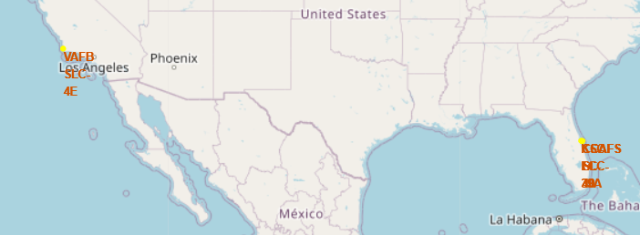
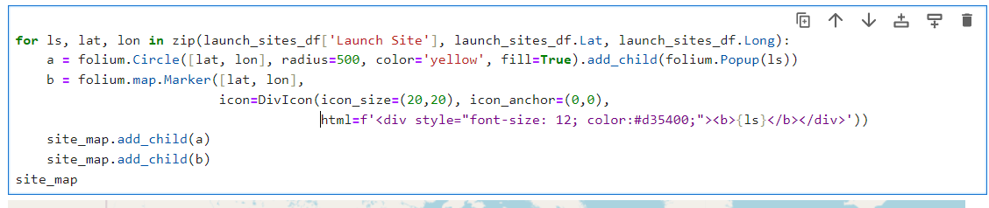
Launch Site Location Folium Map
Launch sites are marked and circled in the map

Slide 36
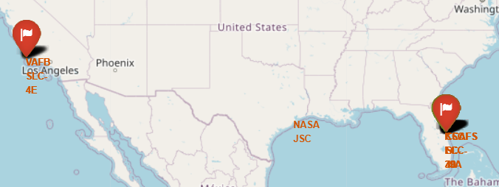
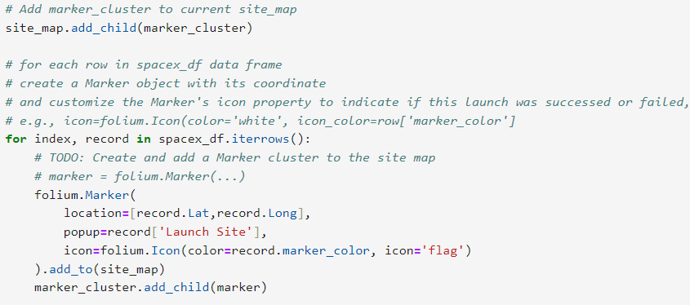
Color Labeled Launch Outcomes
Launch outcomes are labeled with colored markers according to their success and location.

Slide 37
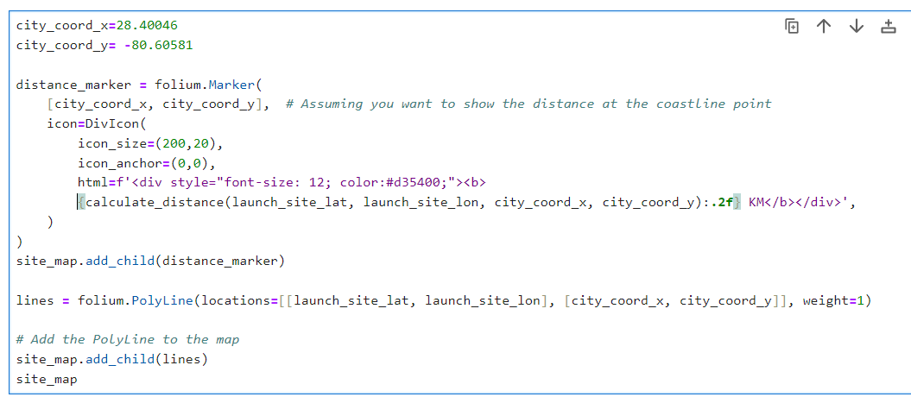
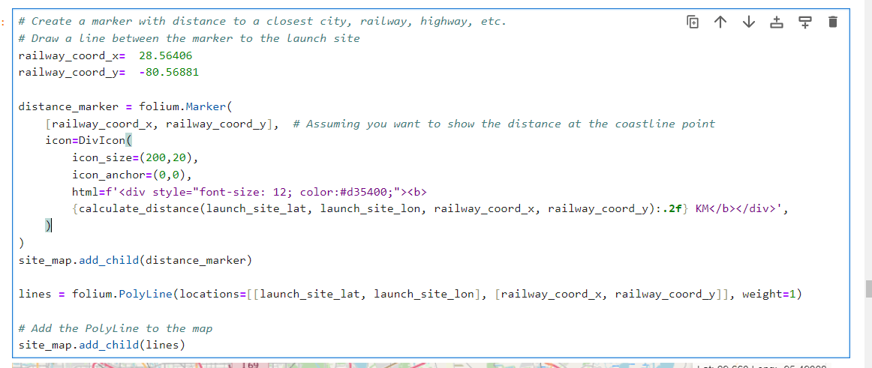
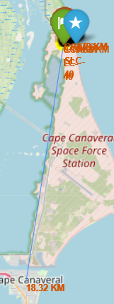
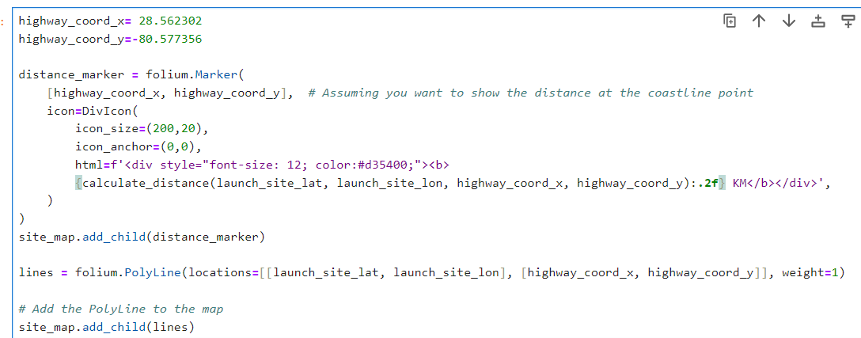
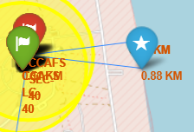
Closest Proximities (railway, highway, coastline, city)
Closest proximities of a launch site labeled with market with written distance and lines between the proximities and the launch site are drawn.

Slide 38

Section 4

Slide 39
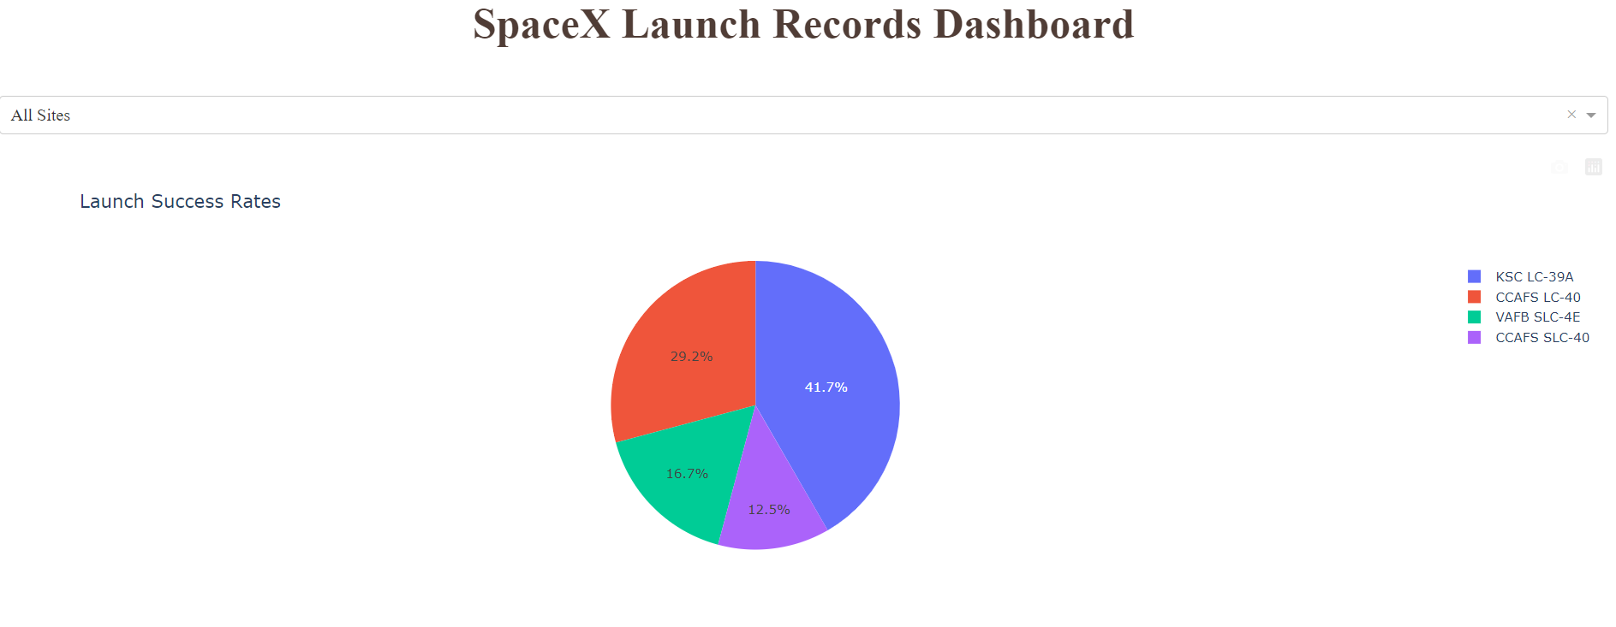
Launch Success Percentages Pie Chart
Pie chart is drawn to have all launch sites and show their percentages of successes.

Slide 40
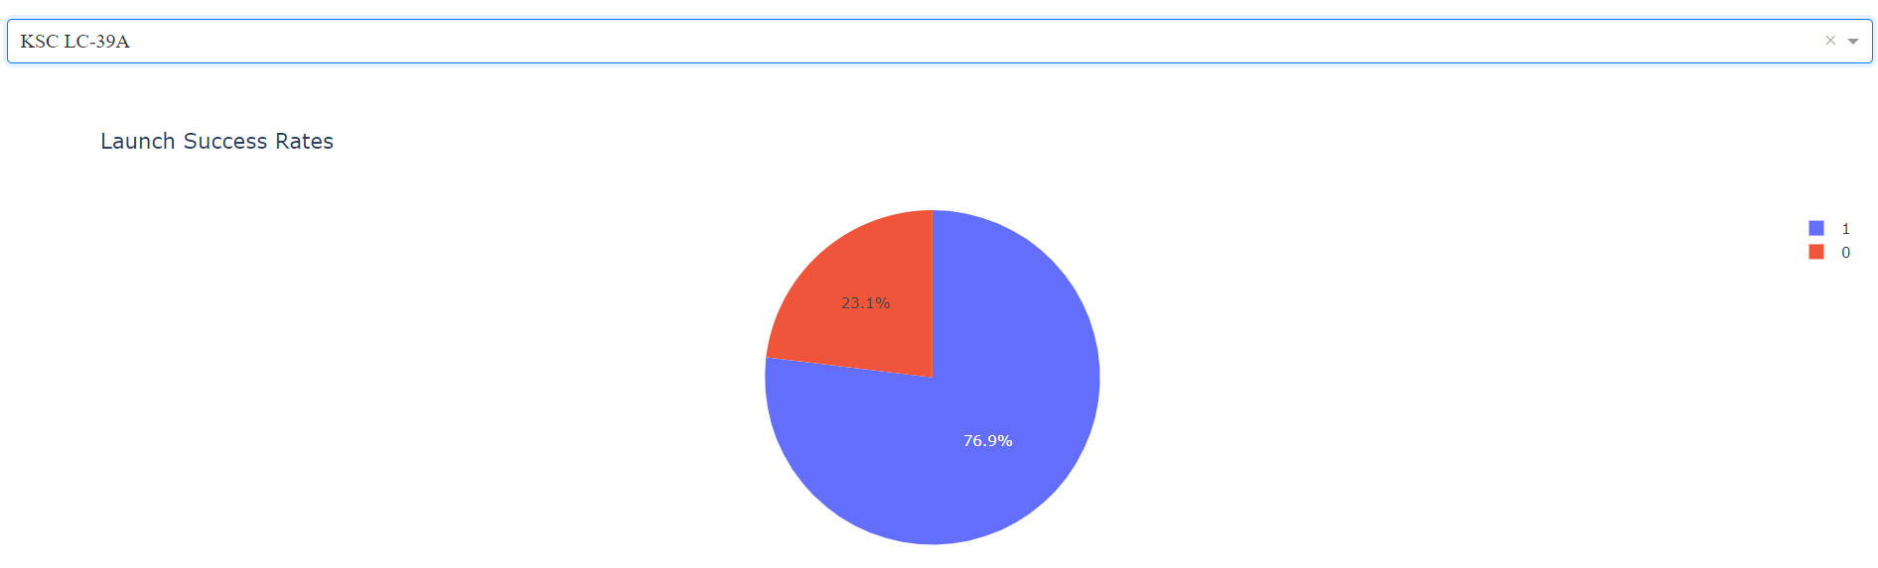
Launch Site with the highest success rate
When we filter the launch sites with the dropdown list, we can reach success rate for the given launch site.

Slide 41
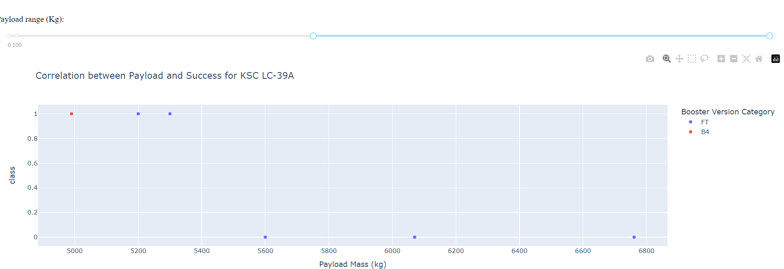
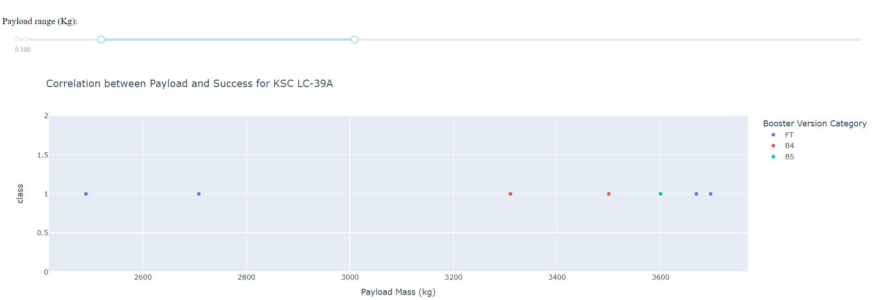
Payload vs Launch Outcome Scatter Plot with Range Slider
Scatter plot and range slider are connected with the callback function. Scatter plot shows launch outcome for the given range of payload mass by the range slider.

Slide 42

Section 5

Slide 43
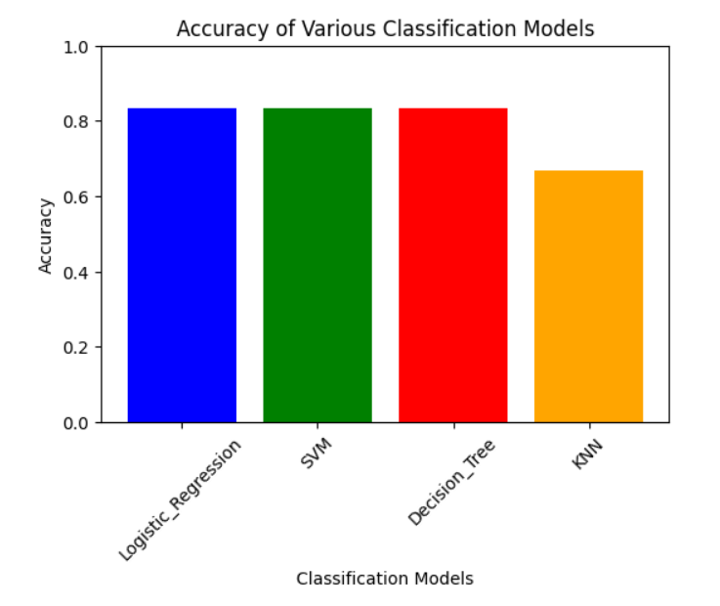
Classification Accuracy
Logistic Regression, SVM and Decision Tree are together have the best accuracy.

Slide 44
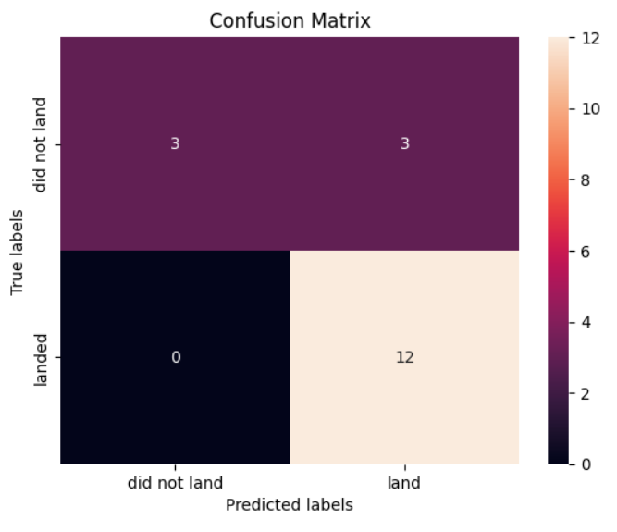
Confusion Matrix
Confusion matrix of decision tree is shown.

Slide 45


